Slide 1

Finding MIMO
Weekly Meeting: Week 8
Kate Bowers, Kristopher Jung, Samuel Spillane

Slide 2
Project Goals
Model receiver-side CEs to determine the best way to decode received signals
Choose equalization algorithm and parameters √
Choose channel estimation technique √
Optimize parameters for the best Bit Error Rate (BER), Power Gain, or throughput √
Create a working MIMO implementation with equalization
Create a high-quality research paper that conveys the novelty of our project

Slide 3

Progress and challenges
Completely redid and generalized (M x N) MIMO model
Original strategy not representative of Watterson model
Stdchan compatible with SISO
Immediate improvement in performance of equalizers
Wasted time trying to fix equalizers when channel model was creating the issues
Matlab equalizers also has lot of issues dealing with MIMO systems.
Implemented ZF/MMSE/MLD by hand.
Started implementing DFE by hand
Completed visualization block to format simulation results

Slide 4
Progress and challenges Contd.
Sam finished Q-learning algorithm and began the writing process.
Q-Learning
Works on a continuous cycle, always optimizing all parameters for each equalizer. Always finds global optima, while being more efficient than previous versions.
Writing
Began reading papers to acquire examples of research writing and began plotting the abstract.

Slide 5
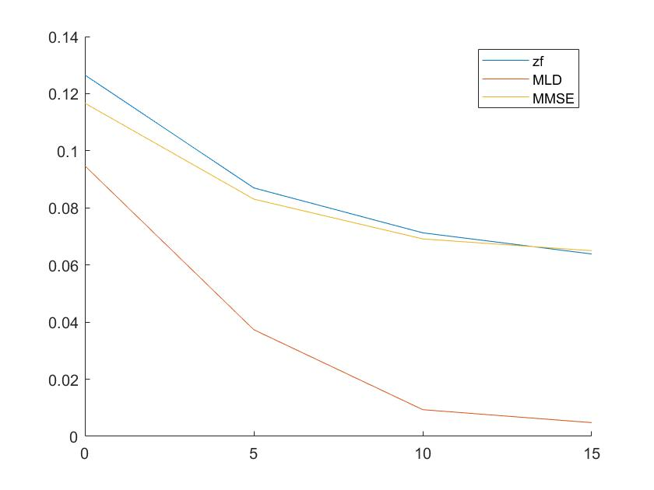
ZF/MMSE/MLD
3 x 2 MIMO Watterson
BPSK
100 iteration per SNR
BER vs SNR
50 symbols each transmitter per iteration for the sake of time.

Slide 6
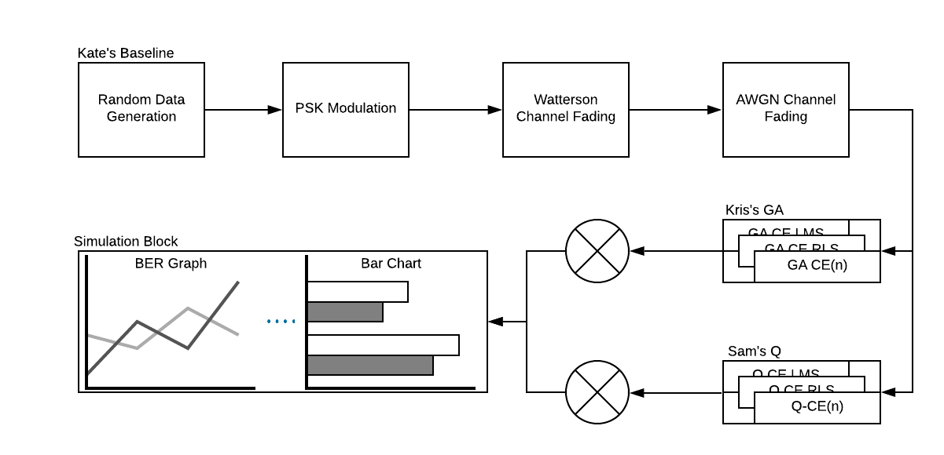
End-game research design.

Slide 7
Roadmap
Week 8-10
Finish DFE equalizers
Integrate all CEs
Finalize project tasks
Research paper writing
Research poster/video for presentation

Slide 8
Questions?

